Slide 1


Welcome to Course-Yuga
A Comprehensive CMS + LMS Platform
Bringing Learning and Content Management Together

Slide 2
Why We Need Course-Yuga
- Disjointed user experience in existing systems
- Lack of seamless integration for courses, videos, and community
- Limited interactivity and course management complexity
- High cost of implementing separate systems for CMS and LMS

Slide 3
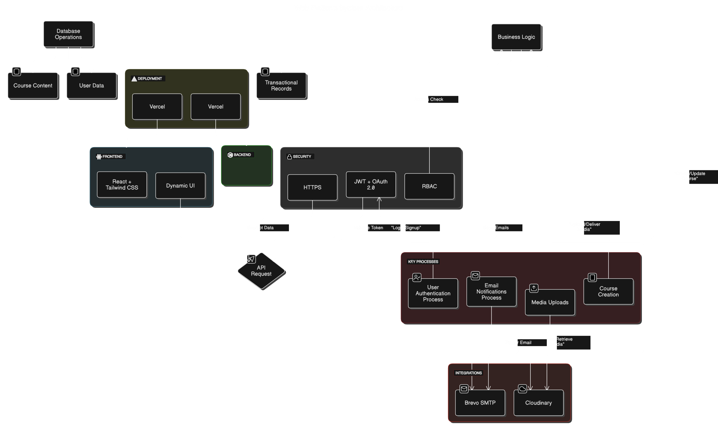
System Design

Slide 4
Technologies
Programming Language: TypeScript
Frontend: React + Tailwind CSS
Backend: Nodejs + Express.js
Database: MongoDB
Integrations: Cloudinary, Brevo SMTP
Deployment: Vercel (Frontend + Backend)
Enhanced security: JWT-based authentication & Oauth2.0

Slide 5
User Interactivity
Enroll in courses and track progress.
Change the role to ADMIN and create their own course.
Watch videos with timestamps or embedded YouTube links.
Bookmark and mark videos as watched.
Engage in the community board.

Slide 6
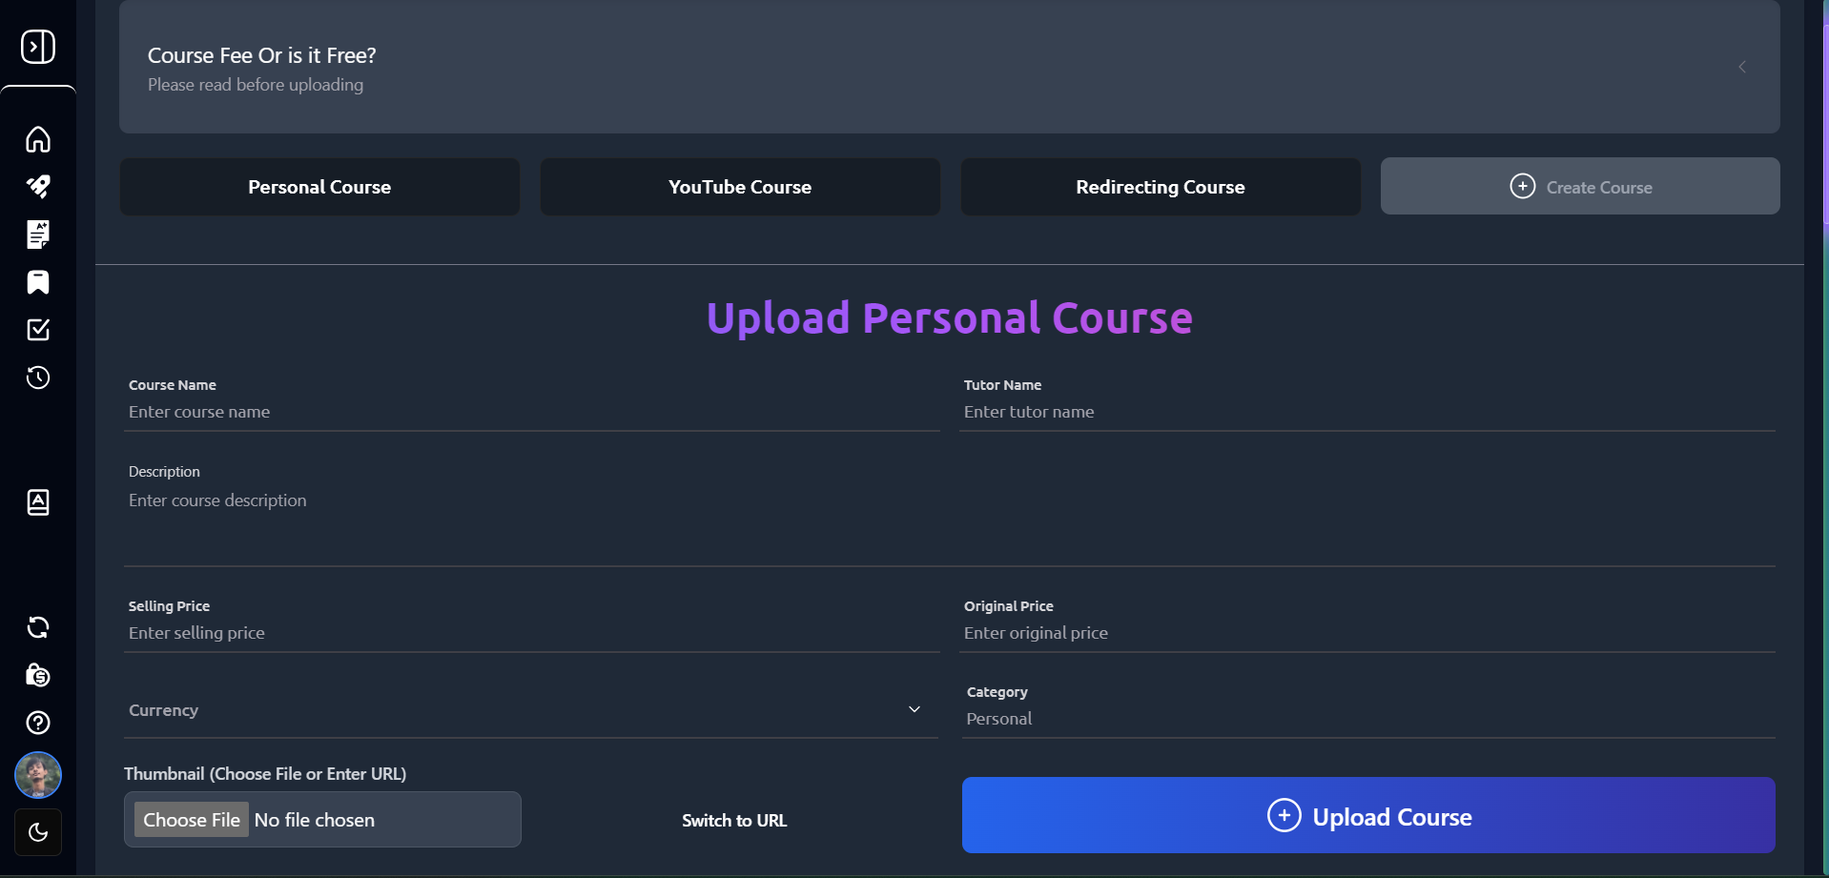
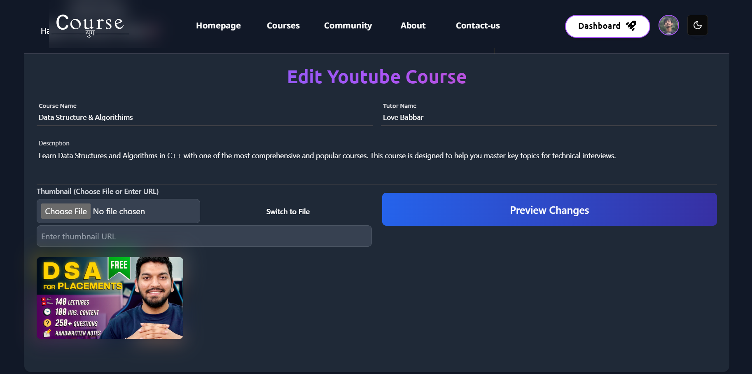
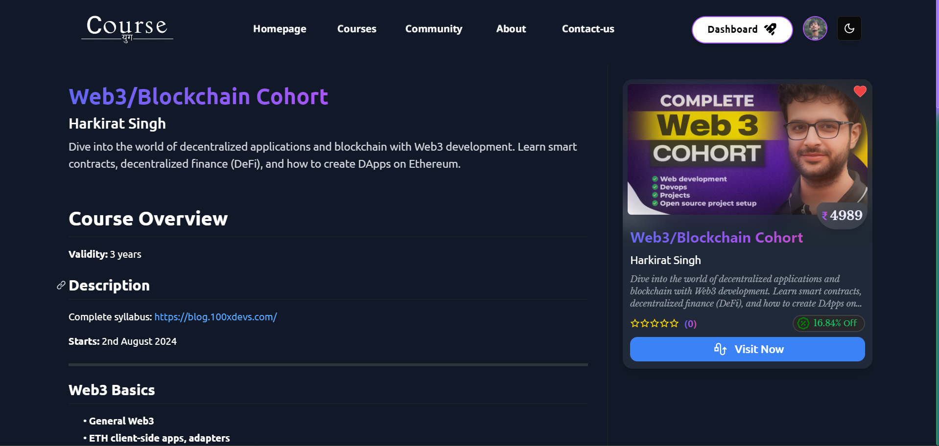
Admin Interactivity
Create and manage courses
Edit course and videos
Set course prices and top up wallets

Slide 7
Web Owner Interactivity
Verify or reject courses and videos
Web owners have the ability to review submitted content for quality and relevance before approval. This ensures a curated library of courses and videos.
Send email notifications for content approval/rejection
Automated email notifications are sent to course creators or admins, keeping them informed about the status of their submissions.
Manage overall platform content quality
Monitor and maintain the platform's integrity by ensuring the uploaded content meets the desired standards of quality and engagement.

Slide 8
Future Enhancement
AI-driven personalized course recommendations
Mobile application for iOS and Android
Advanced analytics for course performance
Multilingual support for global accessibility

Slide 9
Conclusion
Course-Yuga is more than just a platform; it’s a holistic solution to the challenges faced by educational content providers. It offers a robust, scalable, and cost-effective system that will help both content creators and learners achieve their goals with ease.

Slide 10
Thank You!
Course-Yuga
Empowering Learning, Simplifying Content Management
Visit us at: course-yuga.app
Issues: course-yuga-issues
For queries: masterutsav.in@gmail.com

